Slide 1
Authoring Profiles
Ewout Kramer
Jan. 20 2014

Slide 2
This presentation
Can be downloaded here:
http://gforge.hl7.org/svn/fhir/trunk/presentations/2015-01 Tutorials/Authoring Profiles.pptx
Use “anonymous” and email address to logon
Is licensed for use under the Creative Commons, specifically:
Creative Commons Attribution 3.0 Unported License
(Do with it as you wish, so long as you give credit)

Slide 3
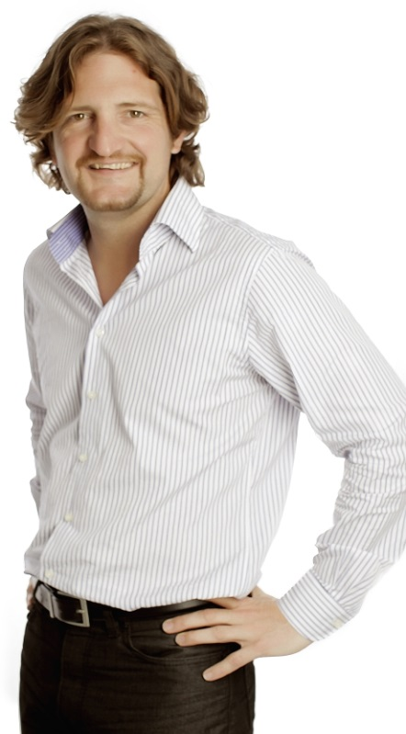
Who am I?
Name: Ewout Kramer
Company: Furore, Amsterdam
Background:
FHIR core team, RIMBAA
Software developer & healthcare architect
Contact:
e.kramer@furore.com
www.thefhirplace.com

Slide 4
Introduce ourselves
Who has looked at Profile in the spec for more than 5 minutes?
Who has near-future needs for authoring profiles?

Slide 5
Contents of this tutorial
Intro to Profiles
Metadata
Structures
Bindings
Formal constraints
Extensions
Slicing
Aggregation

Slide 6
Introduction to profiles
Notes:
Time start-10:00 (10 minutes)

Slide 7
The need for Profiles
Many different contexts in healthcare, but a single set of Resources
Need to be able to describe restrictions based on use and context
Allow for these usage statements to:
Authored in a structured manner
Published in a repository
Used as the basis for validation, code, report and UI generation.

Slide 8
Profiling a resource
“Must use only the Dutch national patient identifier”
+
“Need to register an administrative race code for a Patient in the US”
“Patient Discharge documents must at least contain section “Discharge Medication” and section “Discharge Diagnosis”
+
“In our Patient registration system, we use these maritalStatus codes beyond those provided by HL7…”
“Our patient registration system, only supports having one single name per Patient”
Notes:
Both restrictions (only one single name) and additions (race extension, maritalStatus valueset)

Slide 9
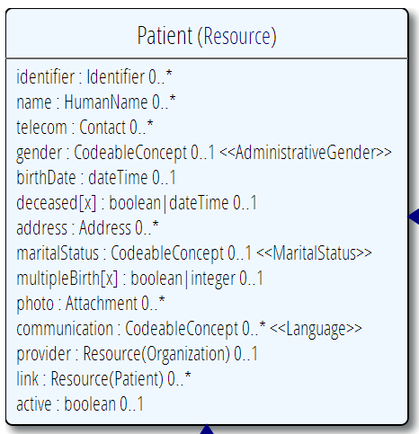
Profiling a resource
Demand that the identifier uses your national patient identifier
Limit names to just 1 (instead of 0..*)
Limit maritalStatus to another set of codes that extends the one from HL7 international
Add an extension to support “RaceCode”
Note: hardly any mandatory elements in the core spec!

Slide 10
Uses for profiles
Server & client may publish and check their conformance to a profile
Validating instances, messages
Implement "FHIR spec-like" website from Profiles as part of an Implementation Guide

Slide 11
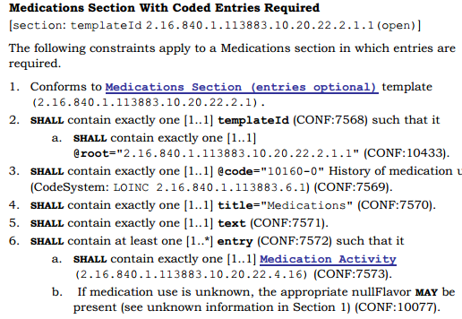
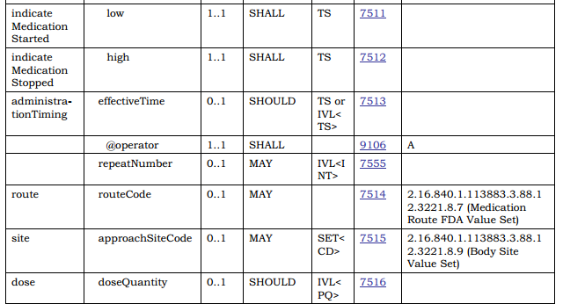
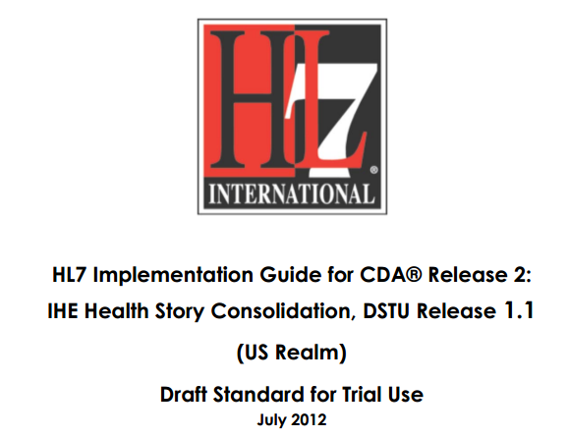
In v3 CDA…”text-based”

Slide 12
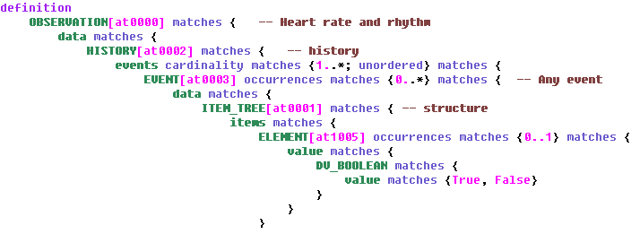
openEHR ADL
…computable!

Slide 13
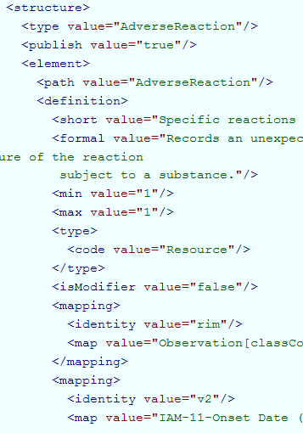
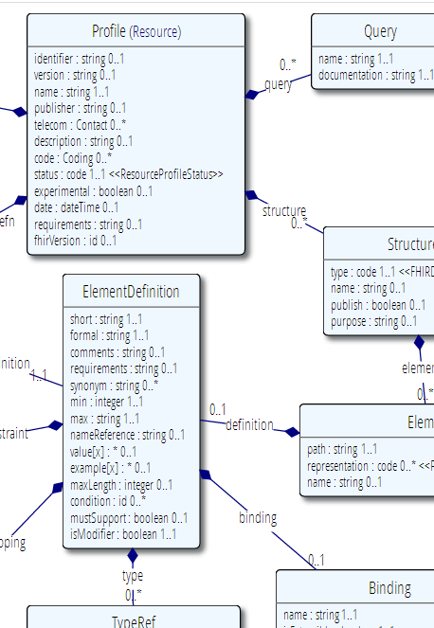
Profile –a “normal” resource
…computable!

Slide 14
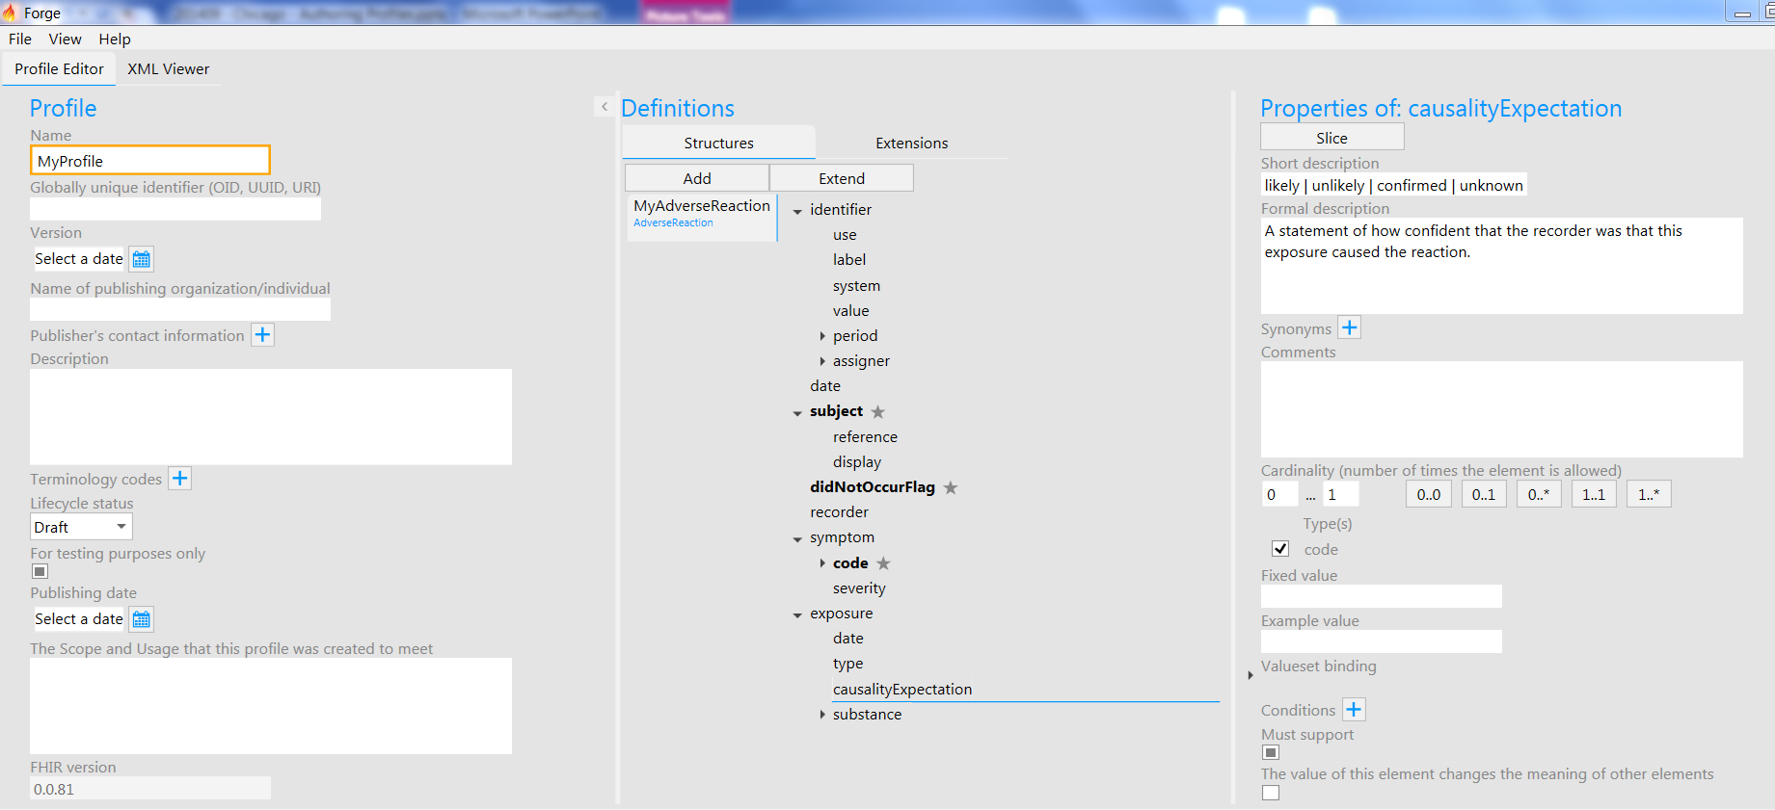
Write by hand? Forge!

Slide 15







Publish them!
Find & maintain
Retrieve & use
http://www.profiles2all.com
Notes:
A profile can be published on a FHIR (based) server (it’s a Resource, after all)
Or in a version-management system, or by e-mail, or…
As long as people can *find* them, because publishing your profile should help others to find & adhere to it.

Slide 16



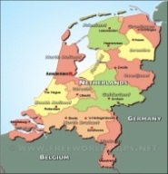
Who publishes?
http://www.hl7.org/Profile/iso-21090
http://www.data4all.nl/d4all-obs
http://www.hl7.nl/Profile/patient-nl
http://www.fit4all.nl/f4all-vitals
http://www.health4all.nl/h4all-vitals
Notes:
“Drive-by” or “bottom-up” operability: “Communicate first, standardize later”
First, business partners. Then, collaborations, communities. Maybe, finally, nation-wide
It’s a natural process that people will want to make it work first, then only coordinate what they really need to, and then realize they can broaden their approach to a community.
“Support”, of course top-down should still be possible! Maybe even a combi in the long-term
You don’t need a central authority to model your data, before you can start.

Slide 17
Tagging a Resource
Patient
MRN 22234
“Ewout Kramer”
30-11-1972
Amsterdam
“I’m a Patient conforming to the Norwegian Profile – see http://hl7.no/Profiles/patient-no”
“I’m a Patient conforming to the ContosoHIS Profile – see http://contoso.no/Profiles/patient”
“I’m a Patient conforming to the Austrialian Profile – see http://hl7.org.au/Profiles/patient-au”

Slide 18
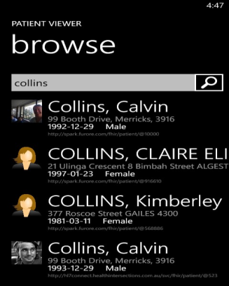
(Distributed) validation
ContosoHIS’s server
Profile NO
Profile Contoso
Profile Contoso
Store
Validate NO
Download & Validate
Profile NO
Norway national validation server
Notes:
A server might defer validation to another server (because it doesn’t know the profile)
A server may fetch the “unknown” profile and validate it itself
There may be several servers sharing the work

Slide 19
Running example…
We are taking the “Lipid Profile” example from the spec from now on.
This is a DiagnosticReport, containing 4 results:
1x Cholesterol
1x Triglyceride
1x HDL Cholesterol
0/1x LDL Cholesterol
And package it up in a message

Slide 20
Metadata and versions
Notes:
Time start-10:00 (10 minutes)

Slide 21
What’s in a profile?
Profile at http://acme.org/Profiles/lipids-v1
Metadata “Lipid Profile” v1.0.0 Draft
urn:acme.org:lipid-profile:v1
Author: e.kramer@furore.com
DiagnosticReport instances (via Tag)
DiagnosticReport instance (via Tag)
DiagnosticReport instance (via Tag)
Extension ‘calculated’
Structure “LipidProfile”
Structure “Triglyceride”
Structure “LDLCholesterol”
Notes:
TODO: You could spread this out over multiple profiles….[there’s only a single slide about this, expand]
Key point: a profile is a “package” with metadata and multiple bits of actual content: extensions and structures. Like a “zip archive”. It’s one whole resource, so everything gets published and versioned as one package

Slide 22
Profile metadata
Publisher: organization or individual responsible for publishing. Should be populated (e.g. “FHIR Project Team“)
Telecom: one or more contact points of the publisher (telephone, email, website etc)
Description: longer description of the contents of the profile
Code: one or more coded descriptions to help with finding the profile
Status (fixed choice of draft, active, retired) + experimental Y/N
Requirements: scope & usage (the “need” or “why” of the profile)
Date (of publication), YYY-MM-DD, e.g. “2013-07-07"

Slide 23
Referring to a profile
DiagnosticReport
Lipid Report
Wile E. COYOTE
2009-03-03 14:26
Cholesterol 6.3 mmol/L
Triglyceride 1.3 mmol/L
HDL Chol. 1.3 mmol/L
LDL Chol. 4.2 mmol/L
Dr. Pete Pathologist,
Acme Labs
1. Where?
http://acme.org/Profile/lipids-v1
( or
http://acme.org/Profile/87408b94
or
any valid technical FHIR id, not
necessarily “comprehensible” )
I’m conforming to
http://acme.org/Profiles/lipids-v1

Slide 24
More naming
So, Profile has a REST id on a server
Might not be under your control, server assigned
But also:
A “name” – human readable, e.g. “Lipid Profile”
An “identifier” – author-assigned, globally unique
OID (2.16.840.1.113883.10.20.2.1)
UUID (09bd961e-c629-11e3-8841-1a514932ac01)
URN
urn:openEHR.org:EHR-ACTION.medication.v1
http://hl7.org/fhir/Profiles/iso-21090-2011

Slide 25
Versioning…
A “version” – author assigned
So what if you change something after publishing?
Just a typo? Change of definition?
Make something optional that wasn’t?
Make something mandatory that was optional?
Add an extension?

Slide 26
“Non-breaking change”?
If old data can still be:
Validated against the new profile
Correctly interpreted against the new profile
This can only be determined by the profile’s authors (and even depends on the way it is used)
A breaking change means you are producing a new profile
The profile’s author-assigned identifier changes
A new Profile on the server, with a new REST utl
Notes:
* E.g. changing the order of questions may in some context considered breaking interpretation, while in others it is not.

Slide 27
Versioning schema
We used semantic versioning
Uses “<major>.<minor>.<patch>”
See semver.org
Major version number is increased on breaking changes
Major version number is part of author-assigned identifier AND REST url
Both versions may co-exist on server, they have different URLs and names

Slide 28
Example
Url | http://fhir.nl/Profile/patient.v1
Id | urn:fhir.nl:profile:patient:v1
Version | 1.0.0
…after a small typo, clarification or correction (“bugfix”) becomes…
Url | http://fhir.nl/Profile/patient.v1
Id | urn:fhir.nl:profile:patient:v1
Version | 1.0.1
…after a bigger non-breaking change, like an addition, becomes…
Url | http://fhir.nl/Profile/patient.v1
Id | urn:fhir.nl:profile:patient:v1
Version | 1.1.0
…after a breaking change (like cardinality) becomes…
Url | http://fhir.nl/Profile/patient.v2
Id | urn:fhir.nl:profile:patient:v2
Version | 2.0.0

Slide 29
Authoring a Profile
Let’s do this in Forge
Chose: “New Empty Profile”
A screen to input Profile metadata appears
& Save

Slide 30
Structures
Notes:
Time start-10:00 (10 minutes)

Slide 31
What’s in a profile?
Profile at http://acme.org/Profiles/lipids-v1
Metadata “Lipid Profile” v1.0.0 Draft
urn:acme.org:lipid-profile:v1
Author: e.kramer@furore.com
DiagnosticReport instances (via Tag)
DiagnosticReport instance (via Tag)
DiagnosticReport instance (via Tag)
Extension ‘calculated’
Structure “LipidProfile”
Structure “Triglyceride”
Structure “LDLCholesterol”
Notes:
TODO: You could spread this out over multiple profiles….[there’s only a single slide about this, expand]
Key point: a profile is a “package” with metadata and multiple bits of actual content: extensions and structures. Like a “zip archive”. It’s one whole resource, so everything gets published and versioned as one package

Slide 32
Structures
Profiles contain “Structures”: a set of constraints on (nested) elements of a Resource or Datatype
Sort of a “subclass” of a Resource, with specific limits on its elements
Cardinality
Value domains
Invariants

Slide 33
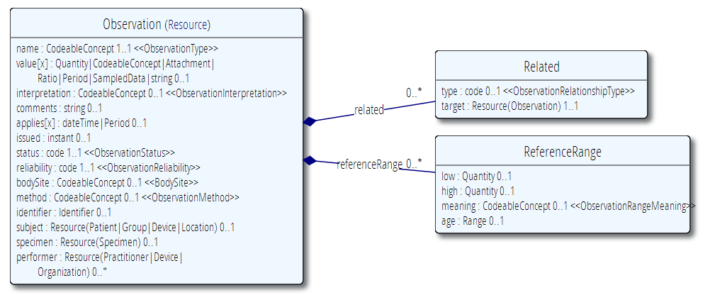
Observation resource
Notes:
Note: Subject 1..1 & is a Patient. You’ll almost always want Patient, unless you’re sending a message “Retract Observation”, then you’d only need “identifier”

Slide 34
Example
“Cholesterol observation” is an Observation :
That has a fixed LOINC code 35200-5 (Cholesterol) as its name
Has a quantity as value that’s expressed in mmol/L (a UCUM unit) (without a ‘comparator’) OR ELSE there’s a comment
An interpretation limited to LL,L,N,H,HH
A “recommended” high reference range of 4.5 (no low) mmol/L, independent of age (no age)
Is an independent observation (no related)

Slide 35
Let’s start constraining
0..1
“if no value…”
= ‘ok’
1..1
Subject 0..1? Why not 1..1 in spec?
1..1
Notes:
Note: Subject 1..1 & is a Patient. You’ll almost always want Patient, unless you’re sending a message “Retract Observation”, then you’d only need “identifier”

Slide 36
My First Structure
Let’s do this in Forge
In the middle, under “Structures” press “Add”
Name the structure “cholesterol” using the property panel on the right.
Start setting the cardinalities for each element, by clicking on them in the middle and using the property panel

Slide 37
Referring to a structure
Observation
Cholesterol
6.3 mmol/L
High
(recommended 4.5)
http://acme.org/Profiles/lipids-v1
Metadata “Lipid Profile” v1.0.0 Draft
urn:acme.org:lipid-profile:v1
Author: e.kramer@furore.com
Structure “cholesterol”
I’m conforming to
http://acme.org/Profiles/lipids-v1#cholesterol
Notes:
* You can formalize these constraining statements into a Profile Structure called ‘cholesterol’
* An Observation instance may use a Tag to assess conformance to that structure
* Validators check the contents of the instance against these constraints.

Slide 38
Reusable constraints
We have multiple components within the “Lipid Profile” with Quantity
All with the same constraints
Units are mmol/L
in UCUM (http://unitsofmeasure.org)
no comparator
Let us first make a reusable “lipid quantity” constraint on the Quantity datatype!

Slide 39
bindings
Notes:
Time start-10:00 (10 minutes)

Slide 40
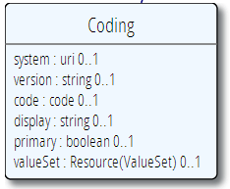
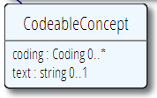

Coded types
In a Profile, we may want to limit the codes that can possibly be used in coded elements in the Resources
Codes are defined in code systems

Slide 41
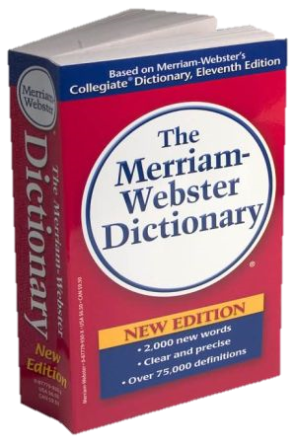
CodeSystem vs. ValueSet
“Dante’s deadly sins”
Pride
Envy
Wrath
Sloth
Avarice
Gluttony
Lust
Takes concepts from…
An enumeration of terms
Defintion of terms
“Code System”
“ValueSet”
Example: SNOMED-CT
Example: “Childhood diseases”

Slide 42

“Special” cases
No need to write them all down!
Takes concepts from…
“All words under B”
“All words in the
Merriam-Webster dictionary”
“Words for ‘nerd’”
Bookworm
Geek
Grind
Weenie
Wonk
Dink (slang)
Dork (slang)
Swot (slang)
Takes concepts from…
Takes concepts from…
Can take concepts from multipe codingsystems!

Slide 43
Identification of CodeSystems
If you refer to CodeSystems, you use a URL (instead of OID in v2 and v3):
http://snomed.info/sct
http://loinc.org
http://hl7.org/fhir/sid/icd-10
We have introduced them for v2 and v3:
http://hl7.org/fhir/v2/0078
http://hl7.org/fhir/v3/ActClass
Notes:
Some codesystems don’t have an “official” url yet (used to be OID)

Slide 44

Coded types (again)
The url of the system
May aid interpretation

Slide 45
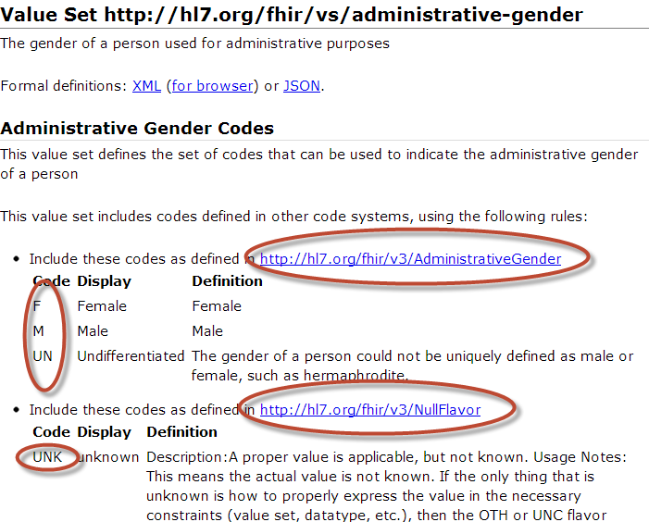
Notes:
Bindings use ValueSets to define what codes are allowed.
Patient.administrativeGender has a binding using the valueset “http://hl7.org/fhir/vs/administrative-gender”
This valueset includes codes from two code systems http://hl7.org/fhir/v3/AdministrativeGender and http://hl7.org/fhir/v3/NullFlavor
So yes, FHIR reused code systems from v3 (and v2), and has some defined specifically for FHIR.

Slide 46
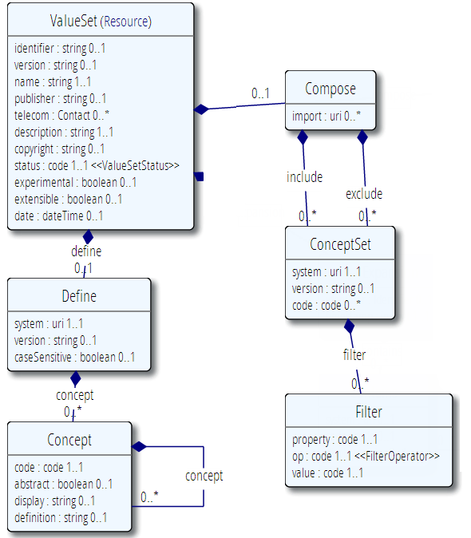
This models what we have been discussing so far:
A ValueSet has metadata (much like Profile: identifier, version, name, etc)
A ValueSet is built by inclusion of terms from CodeSystems
A ValueSet can exclude specific codes from other valuesets
A ValueSet can import codes from other ValueSets
Metadata
In/exclude concepts

Slide 47
But it can also enumerate (and so indirectly define) all concepts for a new codesystem
A ValueSet has metadata (much like Profile: identifier, version, name, etc)
A ValueSet is built by defining terms from and for a new CodeSystem
These new concepts have a display label and a definition
…and may be hierarchically organized

Slide 48
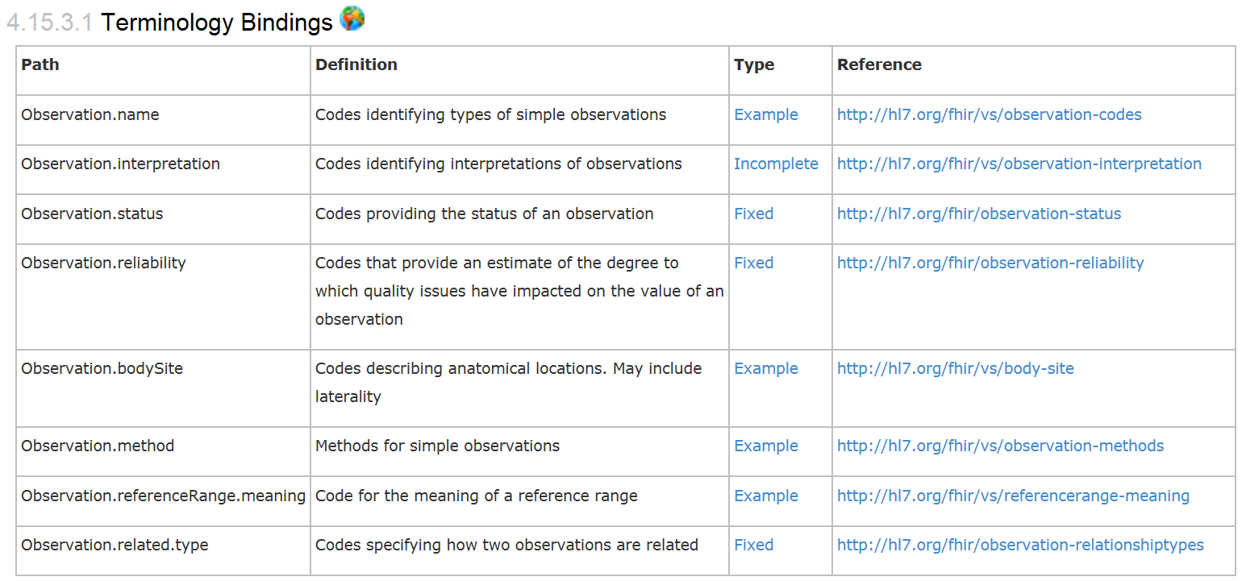
Bindings
When used in a Resource, the modelers include Bindings
Bindings specify which codes can be used
Notes:
Examples is from http://www.hl7.org/implement/standards/fhir/observation.htm
Bindings can be Incomplete (HL7 defines some codes for it, but you can add your own), Fixed (HL7 defines the only codes that are allowed) and Example (no specific codes defined, but some are given to give you an idea of what goes in the element)

Slide 49
Profiling bindings
Depending on “core” spec, you can:
“fixed”: not specify a different binding
“incomplete”: specify a different binding if needed
“example”: very likely specify a different binding
Change the bindings as specified in core:
Define a new ValueSet
Allow additional codes, Restrict to a subset
Specify whether implementers of your profile can deviate from your valueset.
Notes:
Two aspects: whether you as a profile author can change the valueset and
Whether the user of your profile can provide codes from other valuesets in an instance

Slide 50
ValueSets
In order of precision:
A “true” FHIR ValueSet resource (may be version specific)
A general reference to some web content that defines a set of codes. (e.g. mime types).
A textual description of the possible codes

Slide 51
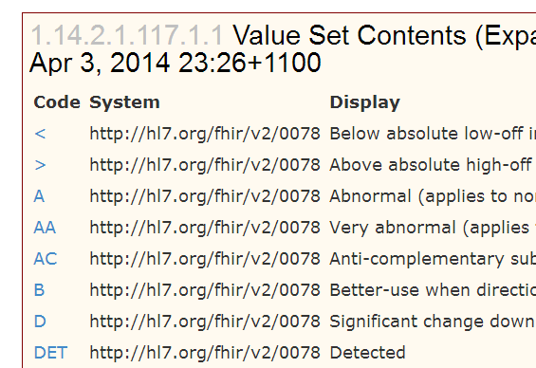
Interpretation Binding
Let us limit http://hl7.org/fhir/vs/observation-interpretation
Let’s Define a new ValueSet using codes from the existing Code system
http://hl7.org/fhir/v2/0078

Slide 52
Creating ValueSets
By tool first….
Grahame is working on a ValueSet editor called “FHIR ValueSet editor”
Early release version is here…

Slide 53
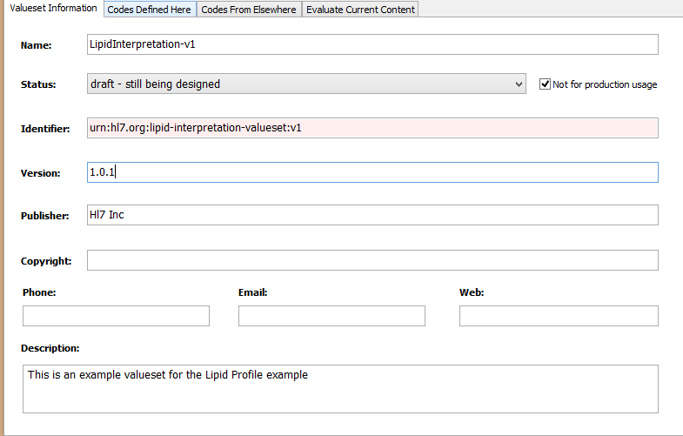
Creating a ValueSet
ValueSet has metadata, just like Profile

Slide 54
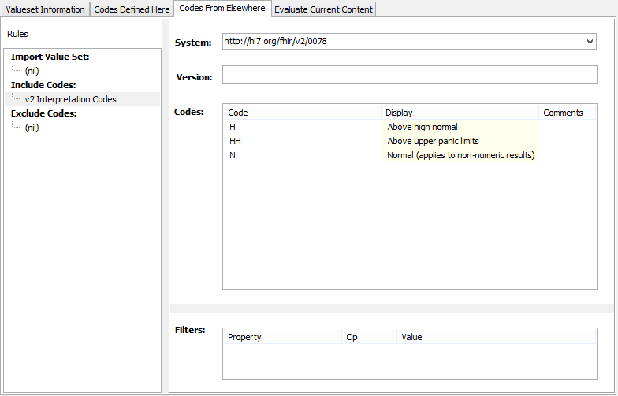
Including codes
Options:
Import a whole ValueSet
Include codes from a Coding System
Exclude codes from a Coding System

Slide 55
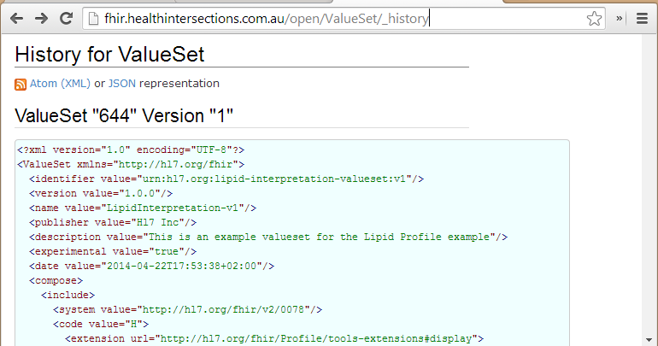
Save to server…

Slide 56
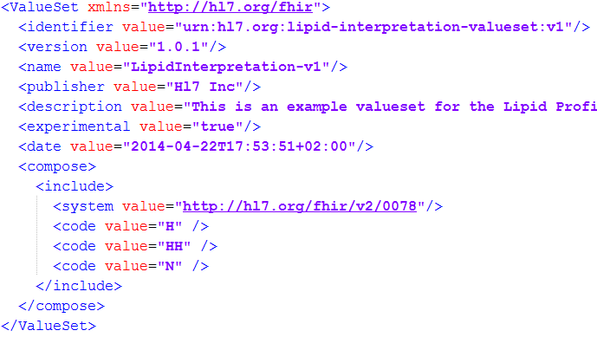
This is not too hard…

Slide 57
Conformance levels
If implementers of your profile provide a different code than you have in your profile….
 | IsExtensible “N” | IsExtensible “Y”
Required “SHALL” | Validation error, non-conformant | Additional codes allowed
Preferred “SHOULD” “Guidance” | Validation warning, discouraged | Supplemental codes likely Alternatives allowed
Example “MAY” | Just a suggestion, no preference

Slide 58
Must support?
Authors: SHALL be capable of providing a value for the element and resource
Consumers: SHALL be capable of extracting and doing something useful with the data element.
"Something useful" is context dependent. The Profile SHALL describe what it means for applications to “support” the element
Notes:
* Note: the spec *never* sets this to true, since it’s context dependent.

Slide 59
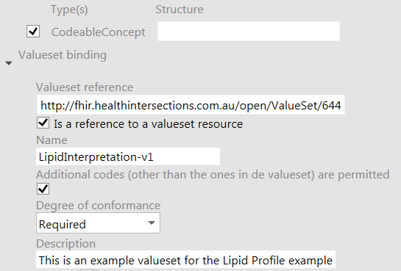
Refer to ValueSet
And now…make the Profile point to the newly created ValueSet using Forge
Notes:
TODO: nieuw plaatje maken

Slide 60
Formal constraints
Notes:
Time start-10:00 (10 minutes)

Slide 61
Formal constraints
…beyond cardinalities and bindings, there are a lot of other conditions you might want to formulate:
“If a Cholesterol value result is not available, use the comments field”
“A patient’s birthdate must be on or before today’s date”
These may concern a single element, or cover multiple elements.

Slide 62
Formal constraints
Uses free text (human) + xpath (executable)
Constraints should be declared on lowest element in the hierarchy that is common to all nodes referenced by the constraint.
Identified by (local) ‘Key’, involved elements refer to that id
Specify severity (“error” or “warning”)

Slide 63
Context of the constraint
“If a Cholesterol value result is not available, use the comments field”
This constraint is on the elements “valueQuantity” and “comments”
We would have to formulate this constraint on the Observation, this is the context of the constraint
We assign the constraint a “key” value that’s unique within the Observations’ constraints
We refer from both “value[x]” and “comments” to this “key”. This means: if my value changes -> revalidate the constraint

Slide 64
Example xpath
Keep in mind: the condition is satisfied when the XPath expression evaluates to “true”
“If a Cholesterol value result is not available, use the comments field”
Note: to use both is ok!
Otherwise said: not both empty
In Xpath: exists(f:valueQuantity) or exists(f:comment)
That’s a logical or, so not exclusive!

Slide 65
More xpath
“Either a valueQuantity or a comment is permitted”
not( exists(f:valueQuantity) and exists(f:comment) )
“Can only have normal range if there is a valueQuantity”
exists(f:valueQuantity) or not(exists(f:normalRange))
Steal from the spec (e.g. from Profile)

Slide 66
Add constraint
Let’s do this in Forge
Click the Cholesterol Observation (that’s the context, remember!), add under the “Constraints” in the property panel
Give it key “chol-01”
Click both “value[x]” and “comment” and set their condition to “chol-1”.

Slide 67
extensions
Notes:
Time start-10:00 (10 minutes)

Slide 68
Extensions
Add the fact that: “a LDL Cholesterol value is calculated”
There’s no such indication on Observation (or Observation.value) -> Extension
!!Note!! - You’re not extending a resource per se, but you specify where an extension applies. This may be multiple places.
So “haircolor” may be applied to “Patient” and “Practitioner”

Slide 69
Extension Context
An extension has a context type
Resource, Datatype, Extension, Mapping
And a context path
(Resource) Observation
“The observation was calculated”
(Resource) Observation.value
“The observation’s ‘value’ was calculated”
(Datatype) Quantity
“This quantity was calculated” (any Quantity used in any resource!)

Slide 70
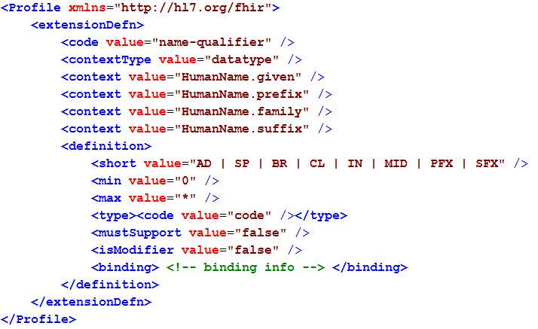
Extension definition
Note: multiple
contexts!

Slide 71
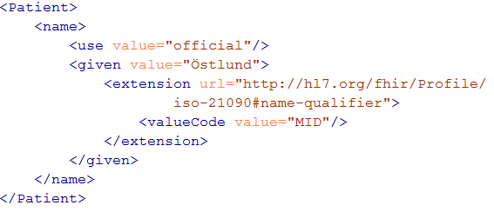
Extending a name
Key = location of formal definition
Value = value according to definition

Slide 72
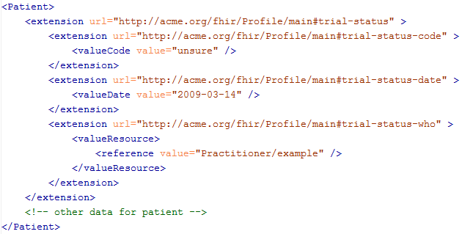
Extending an extension?

Slide 73
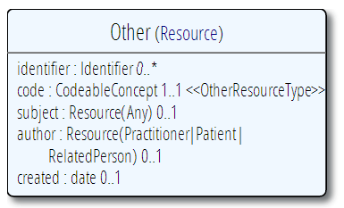
The “Other” resource
Now, what if you have the need for a completely “new” resource?
…then add extensions for each element

Slide 74
Authoring an extension
Let’s do this in Forge
Open the “Extensions” tab in the middle of the screen
Press “Add”
Give it a name, context and datatype

Slide 75
slicing
Notes:
Time start-10:00 (10 minutes)

Slide 76
Where are we?
Cholesterol
Observation name: loinc.org#35200-5
Quantity (lipidQuantity)
TODO:
DiagnosticReport
containing 4 results:
1x Cholesterol
1x Triglyceride
1x HDL Cholesterol
0/1 LDL Cholesterol
use
Triglyceride
Observation
name: loinc.org#35217-9
bind
ValueSet
(lipidInterpretation)
HDL Cholesterol Observation
name: loinc.org#2085-9
Extension
(calculated)
bool
LDL Cholesterol
Observation
name: loinc.org#13457-7
applies
to

Slide 77
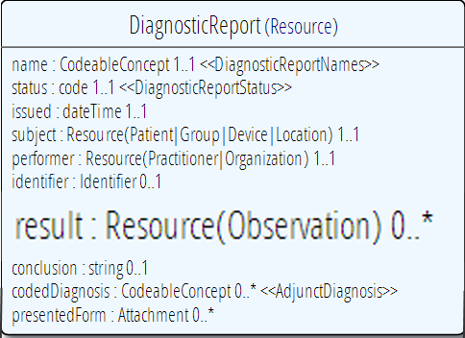
The Diagnostic Report
= loinc.org#57698-3
(Lipid panel with direct LDL)
Cholesterol
1
Triglyceride
1
HDL Cholesterol
1
LDL Cholesterol
0/1

Slide 78
Slicing!
Discriminator
0..*
Result: ResourceReference(Observation)
3..4
Cholesterol
Observation name: loinc.org#35200-5
1..1
ResourceReference(Observation)
ResourceReference(Observation)
1..1
Triglyceride
Observation
name: loinc.org#35217-9
ResourceReference(Observation)
1..1
ResourceReference(Observation)
HDL Cholesterol Observation
name: loinc.org#2085-9
ResourceReference(Observation)
0..1
ResourceReference(Observation)
"There MUST be exactly one Observation
with LOINC 35200-5. And if you find it, it
must conform to our "Cholesterol" Structure
LDL Cholesterol
Observation
name: loinc.org#13457-7
ResourceReference(Observation)
…

Slide 79
Properties of slices
Each slicing group indicates a discriminator
here, that is Observation.name
Each slicing group indicates a cardinality
here, that was 3..4
Each slice indicates its own cardinality within the slice
here 1..1 for chol,trig,hdlc, 0..1 for ldlc
Each slice indicates additional constraints
here "must conform to Cholesterol structure" etc.

Slide 80
Authoring slices
Let’s do this in Forge
Click "result" and then "Slice" above property panel
Indicate the discriminator and the cardinality for the whole slice
Click "Add slice" (4x), and name each slice, give it the cardinality, tie Reference to "#cholesterol", "#triglyceride" etc.

Slide 81
Aggregation
Notes:
Time start-10:00 (10 minutes)

Slide 82
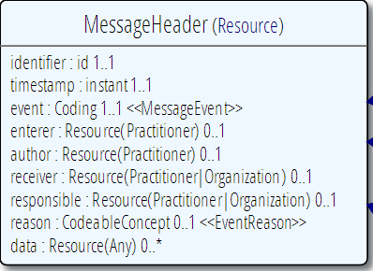
One step further!
Package the DiagnosticReport in a "LipidResultMessage"
Cholesterol
Triglyceride
HDL Cholesterol
LDL Cholesterol
DiagnosticReport
data: Resource(DiagnosticReport#lipidPanel) 1..1

Slide 83
In REST: Possibly distributed…
FHIR server @ pat.registry.org
FHIR server @ lab.hospitalA.org
Patient Joe
Diagnostic
Report A
Message
Header
subject
data
result
FHIR server @ hospitalA.org
FHIR server @ lab2.hospitalA.org
performer
Practitioner Bernard
Cholesterol
Obs 1
Triglyceride
Obs 78
HDL
Obs 34

Slide 84
Maybe we want this…
FHIR Message Bundle
FHIR server @ pat.registry.org
Diagnostic
Report A
Patient Joe
Message
Header
data
subject
result
performer
FHIR server @ hospitalA.org
Cholesterol
Obs 1
Triglyceride
Obs 78
HDL
Obs 34
Practitioner Bernard

Slide 85
Aggregation
Aggregation: for each ResourceReference choose one to all of these options:
Code | Definition
contained | Reference to a contained resource.
referenced | Reference to a resource that has to be resolved externally
..bundled | Reference points to will be found in the same bundle
read: Message, Document

Slide 86
Authoring slices
Let’s do this in Forge
Pick any of the ResourceReferences in the model.
Notice none of the checkboxes next to a ResourceReference is checked: all aggregation types are allowed
Now select those checkboxes to change

Slide 87
Profile = Package
Profile at http://acme.org/fhir/Profiles/lipids-v1
Metadata “Lipid Profile” v1.0.0 Draft
urn:acme.org:lipid-profile:v1
Author: e.kramer@furore.com
newLipidResult
MessageHeader
cholesterol
Observation
#lipidQuantity
lipidQuantity
Quantity
triglyceride
Observation
#lipidProfile
hDLCholesterol Observation
#cholesterol
lDLCholesterol
Observation
calculated
Extension
lipidProfile
DiagnosticReport
#<name> = "in the same Profile"

Slide 88
Package differently
http://acme.org/fhir/Profiles/lipids-v1
http://repository.org/common
Metadata “Lipid Profile”
Metadata
“National Extensions”
newLipidResult
MessageHeader
cholesterol
Observation
repository.org/common#mmolQuantity
#cholesterol
triglyceride
Observation
#lipidProfile
mmolQuantity
Quantity
hDLCholesterol Observation
lipidProfile
DiagnosticReport
lDLCholesterol
Observation
calculated
Extension

Slide 89
How do I package?
Make a profile with just extensions
Make a profile with just 1 resource + extensions on that resource
Make a profile with all (say national) resources + extensions.
Based on what is versioned together
What is authored/maintained by one organization

Slide 90
Finally…
Examples (broken)
http://hl7.org/implement/standards/fhir/profile-examples.html
Forge download
http://fhir.furore.com/forge/
Find this presentation on SlideShare

Slide 91
Questions?

